Slide 1
Software Development with UML and Java 2

Slide 2
Agenda
Flyweight, Factory, Map
Map, collection, what is it
Concept, Key-Value
Example
Flyweight
Motivation
Car example
School example
Flyweight definition
String in java
Parts involved
General UML
Code example, students and courses
Code example, MVVM-ViewHandler

Slide 3
Map
We want to look up something by the use of some key: id, name, etc..
Database - like

Slide 4
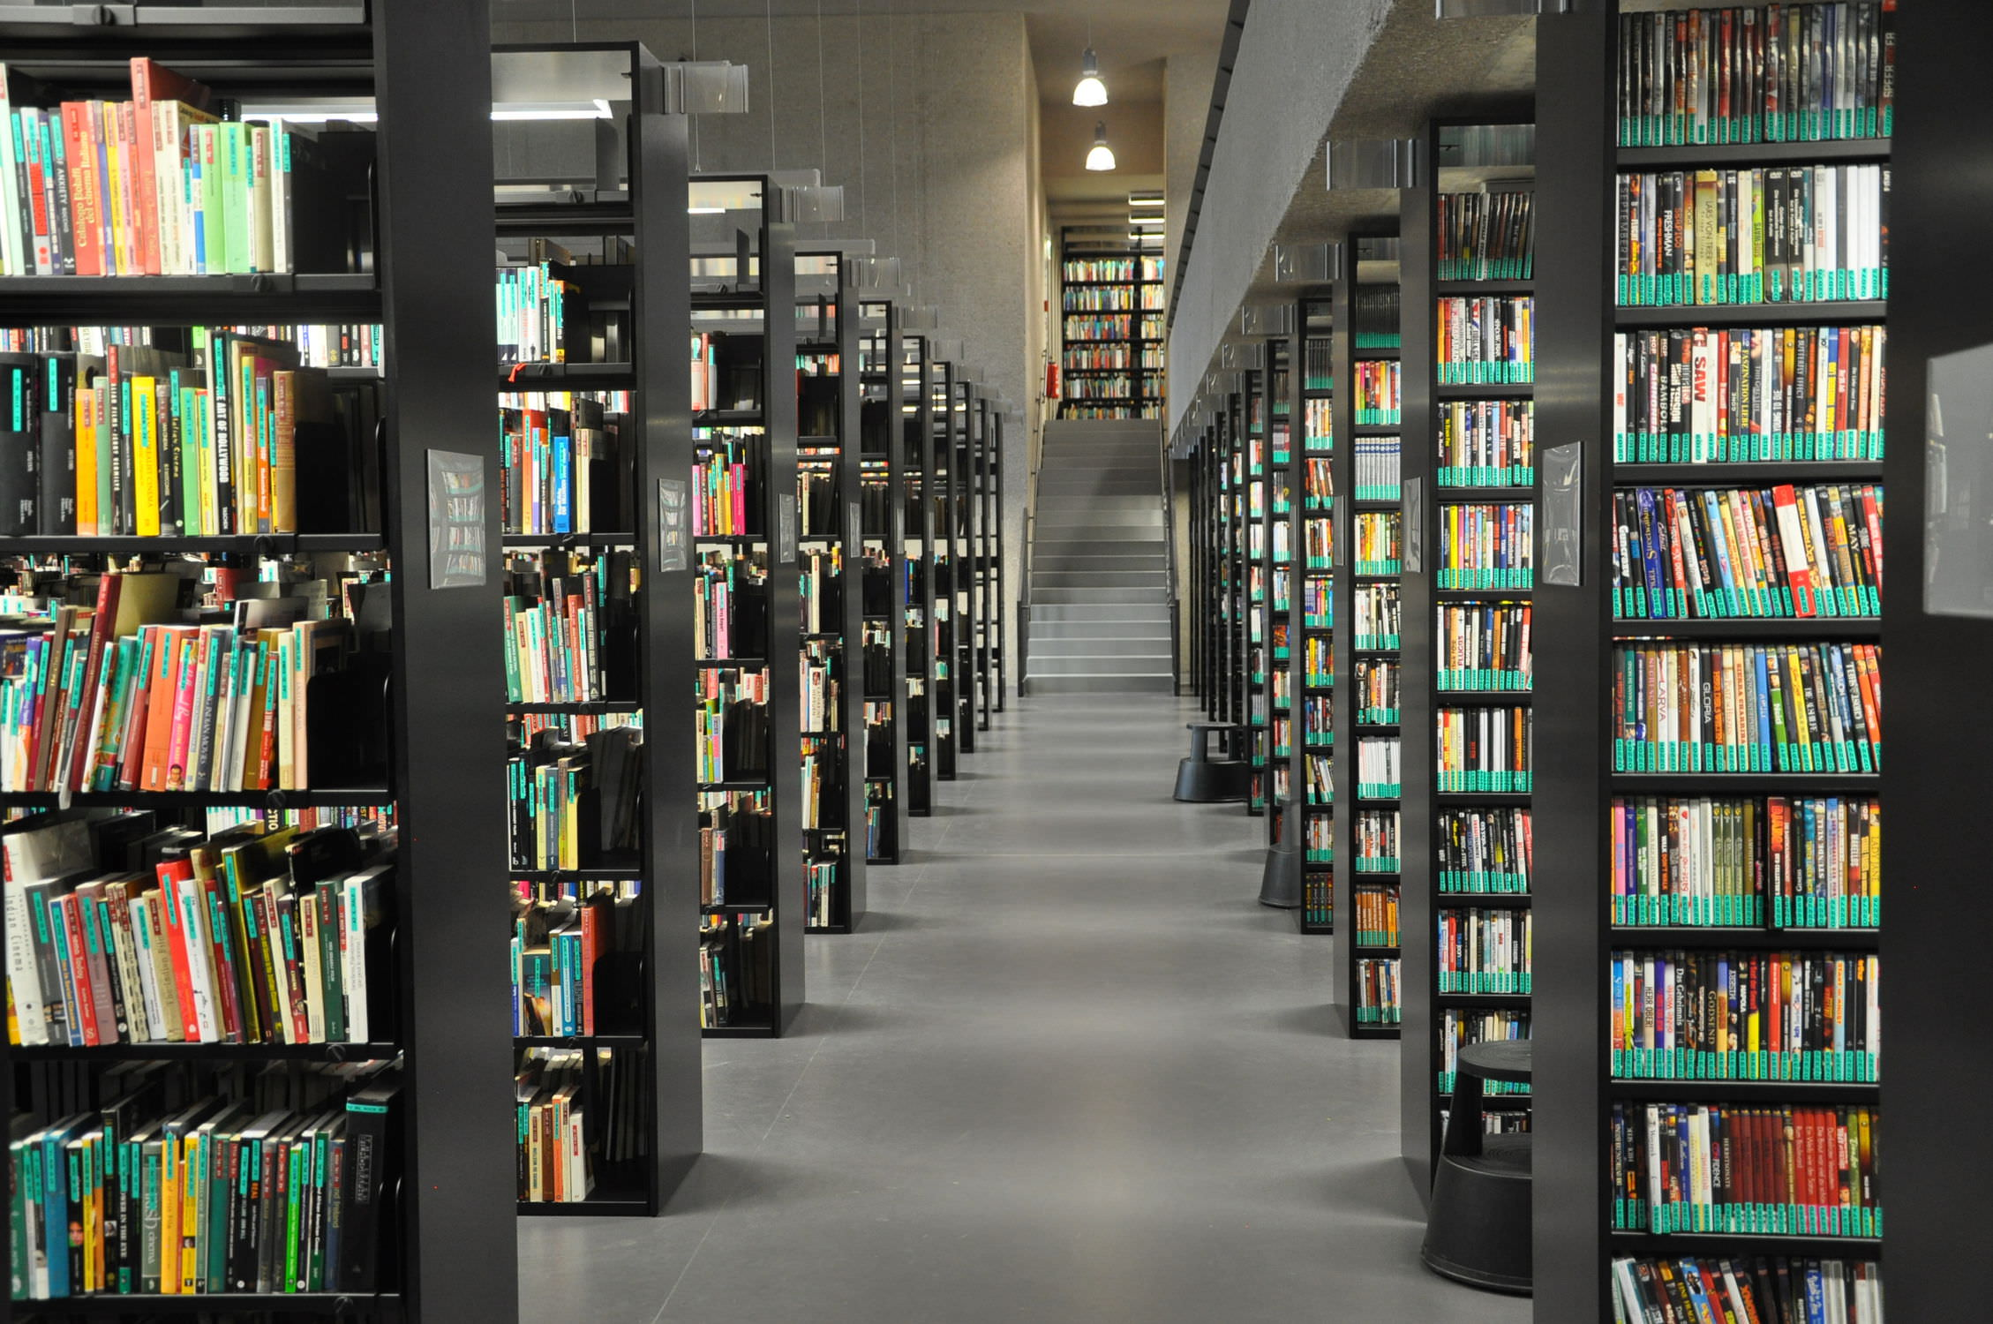
Map
Library: To find a book, you look up the shelf, then find the book on that shelf.

Slide 5

Map
I go to the post office to collect a package/letter
I give them my address
Address is key
Package is value

Slide 6
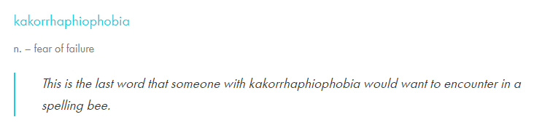
Map
Dictionary: To find the meaning of a word, you look up the word, and get the explanation
Key
Value

Slide 7
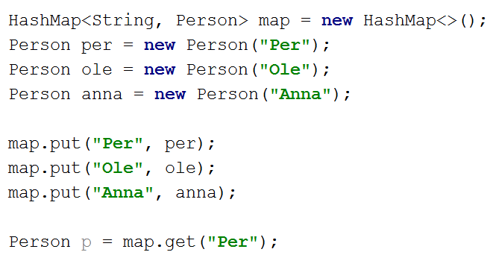
Map
HashMap<K, V> → ArrayList<String>
HashMap<String, Integer>
Key, value pair

Slide 8

Agenda
Flyweight, Factory, Map
Map, collection, what is it
Concept, Key-Value
Example
Flyweight
Motivation
Car example
School example
Flyweight definition
String in java
Parts involved
General UML
Code example, students and courses
Code example, MVVM-ViewHandler

Slide 9
Flyweight
Motivation

Slide 10
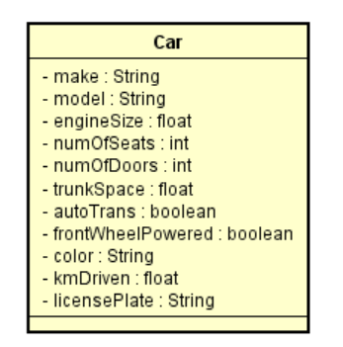
Example: Car
Car1
make: Opel
model: Astra
engineSize: 1.5L
numOfSeats: 5
numOfDoors: 5
trunkSpace: 5.4
autoTrans: false
frontWheelPowered: true
color: red
kmDriven: 57384
licensePlate: LF 56 324
Car3
make: Opel
model: Astra
engineSize: 1.5L
numOfSeats: 5
numOfDoors: 5
trunkSpace: 5.4
autoTrans: false
frontWheelPowered: true
color: green
kmDriven: 3563
licensePlate: TR 23 613
Car2
make: Opel
model: Astra
engineSize: 1.5L
numOfSeats: 5
numOfDoors: 5
trunkSpace: 5.4
autoTrans: false
frontWheelPowered: true
color: blue
kmDriven: 34561
licensePlate: AG 34 942

Slide 11
Example: Car
Car1
make: Opel
model: Astra
engineSize: 1.5L
numOfSeats: 5
numOfDoors: 5
trunkSpace: 5.4
autoTrans: false
frontWheelPowered: true
color: red
kmDriven: 57384
licensePlate: LF 56 324
Lots of duplicate data
Car2
make: Opel
model: Astra
engineSize: 1.5L
numOfSeats: 5
numOfDoors: 5
trunkSpace: 5.4
autoTrans: false
frontWheelPowered: true
color: blue
kmDriven: 34561
licensePlate: AG 34 942
Car3
make: Opel
model: Astra
engineSize: 1.5L
numOfSeats: 5
numOfDoors: 5
trunkSpace: 5.4
autoTrans: false
frontWheelPowered: true
color: green
kmDriven: 3563
licensePlate: TR 23 613

Slide 12
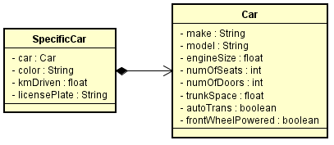
Example: Car
Refactoring
Car
make: Opel
Model: Astra
engineSize: 1.5L
numOfSeats: 5
numOfDoors: 5
trunkSpace: 5.4
autoTrans: false
frontWheelPowered: true
SpecificCar1
car:
color: red
kmDriven: 57384
licensePlate: LF 56 324
Now duplicate instances
Car
make: Opel
Model: Astra
engineSize: 1.5L
numOfSeats: 5
numOfDoors: 5
trunkSpace: 5.4
autoTrans: false
frontWheelPowered: true
SpecificCar2
car:
color: green
kmDriven: 3563
licensePlate: TR 23 613
Car
make: Opel
Model: Astra
engineSize: 1.5L
numOfSeats: 5
numOfDoors: 5
trunkSpace: 5.4
autoTrans: false
frontWheelPowered: true
SpecificCar3
car:
color: blue
kmDriven: 34561
licensePlate: AG 34 942

Slide 13
Example: Car
Refactoring
SpecificCar1
car:
color: red
kmDriven: 57384
licensePlate: LF 56 324
Car
make: Opel
Model: Astra
engineSize: 1.5L
numOfSeats: 5
numOfDoors: 5
trunkSpace: 5.4
autoTrans: false
frontWheelPowered: true
Car
make: Opel
Model: Astra
engineSize: 1.5L
numOfSeats: 5
numOfDoors: 5
trunkSpace: 5.4
autoTrans: false
frontWheelPowered: true
SpecificCar2
car:
color: green
kmDriven: 3563
licensePlate: TR 23 613
Car
make: Opel
Model: Astra
engineSize: 1.5L
numOfSeats: 5
numOfDoors: 5
trunkSpace: 5.4
autoTrans: false
frontWheelPowered: true
SpecificCar3
car:
color: blue
kmDriven: 34561
licensePlate: AG 34 942

Slide 14
We have reduced our memory usage by sharing data

Slide 15

Agenda
Flyweight, Factory, Map
Map, collection, what is it
Concept, Key-Value
Example
Flyweight
Motivation
Car example
School example
Flyweight definition
String in java
Parts involved
General UML
Code example, students and courses
Code example, MVVM-ViewHandler

Slide 16


School system

Slide 17
School system

Slide 18
UML
Biology
teacher : Teacher
classRoom : String
time : Date
Student
name : String
age : int
semester : int
Classes : list<Class>

Slide 19
Biology
teacher : Teacher
classRoom : String
time : Date
Geography
teacher : Teacher
classRoom : String
time : Date
Student
name : String
age : int
semester : int
Classes : list<Class>

Slide 20
Biology
teacher : Teacher
classRoom : String
time : Date
Geography
teacher : Teacher
classRoom : String
time : Date
Chemistry
teacher : Teacher
classRoom : String
time : Date
Student
name : String
age : int
semester : int
Classes : list<Class>

Slide 21
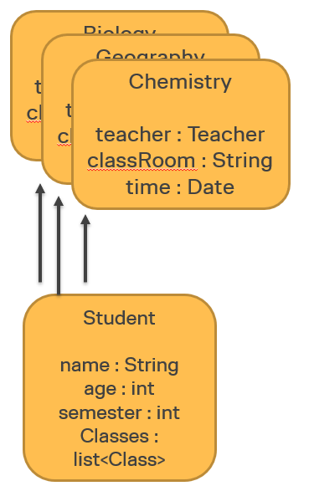
Should they all have their own instances of the classes?
Biology
teacher : Teacher
classRoom : String
time : Date
Geography
teacher : Teacher
classRoom : String
time : Date
Chemistry
teacher : Teacher
classRoom : String
time : Date
Student
name : String
age : int
semester : int
Classes : list<Class>
Student
name : String
age : int
semester : int
Classes : list<Class>
Student
name : String
age : int
semester : int
Classes : list<Class>
Student
name : String
age : int
semester : int
Classes : list<Class>
Student
name : String
age : int
semester : int
Classes : list<Class>

Slide 22
UML
Biology
teacher : Teacher
classRoom : String
time : Date
Geography
teacher : Teacher
classRoom : String
time : Date
Chemistry
teacher : Teacher
classRoom : String
time : Date
Student
name : String
age : int
semester : int
Classes : list<Class>
Student
name : String
age : int
semester : int
Classes : list<Class>
Student
name : String
age : int
semester : int
Classes : list<Class>
Student
name : String
age : int
semester : int
Classes : list<Class>
Student
name : String
age : int
semester : int
Classes : list<Class>

Slide 23

Agenda
Flyweight, Factory, Map
Map, collection, what is it
Concept, Key-Value
Example
Flyweight
Motivation
Car example
School example
Flyweight definition
String in java
Parts involved
General UML
Code example, students and courses
Code example, MVVM-ViewHandler

Slide 24
Design Pattern: Flyweight
Intent
To share objects instead of creating more objects with the same state (the flyweight object)
To have a class responsible for creating objects (the factory)
Example
A Person with a nationality. The same nationality information is shared by more than one person
Pools of worker threads
Reuse Views in JavaFX instead of creating new Views whenever we switch view
Whenever objects can be shared or reused
When you instantiate and destroy many (very many) identical objects
Notes:
Star sign can e.g. contain information about the dates, and an image.
Nationality can contain information about the country.

Slide 25
A flyweight is an object that minimizes memory use by sharing as much data as possible with other similar objects; it is a way to use objects in large numbers when a simple repeated representation would use an unacceptable amount of memory.
https://en.wikipedia.org/wiki/Flyweight_pattern
Basically a type of cache, where we can store objects and reuse them

Slide 26
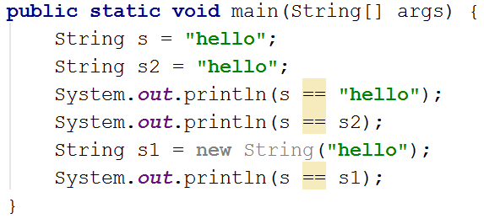
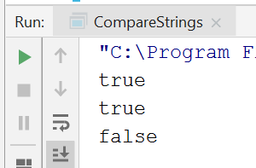
String in Java uses flyweight-ish approach
==
When comparing objects, will compare memory location

Slide 27

Agenda
Flyweight, Factory, Map
Map, collection, what is it
Concept, Key-Value
Example
Flyweight
Motivation
Car example
School example
Flyweight definition
String in java
Parts involved
General UML
Code example, students and courses
Code example, MVVM-ViewHandler

Slide 28
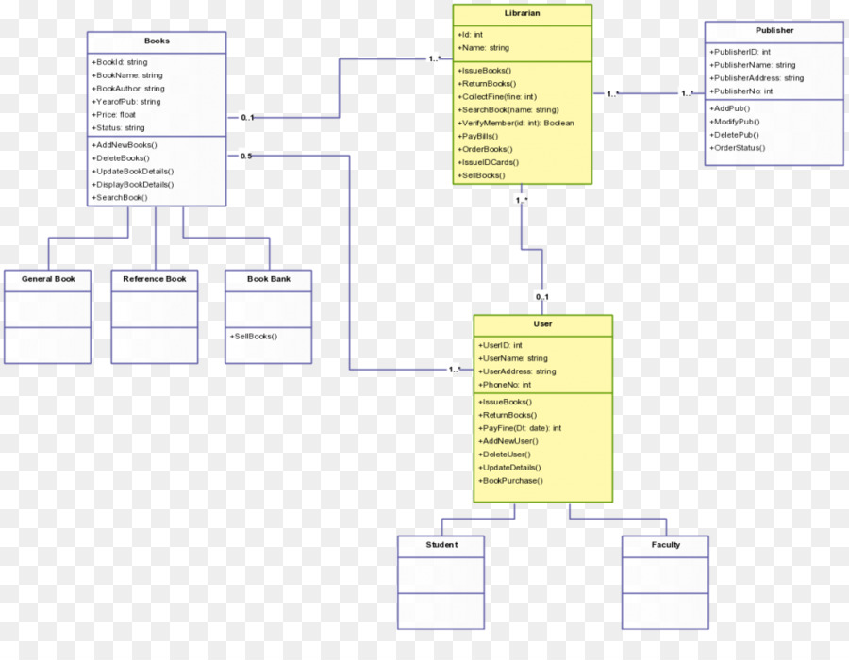
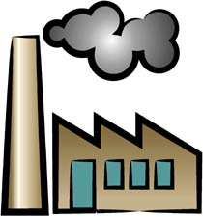
The elements
The factory, which is responsible for creating and holding flyweight objects
The flyweight objects, created by and contained within the factory
Hey, can I get the book “Sins of Empire” from you
System

Slide 29
The elements
The factory, which is responsible for creating and holding flyweight objects
The flyweight objects, created by and contained within the factory
I already had a copy, here you go
System

Slide 30
The elements
The factory, which is responsible for creating and holding flyweight objects
The flyweight objects, created by and contained within the factory
I don’t have that, let me just create it.
System

Slide 31
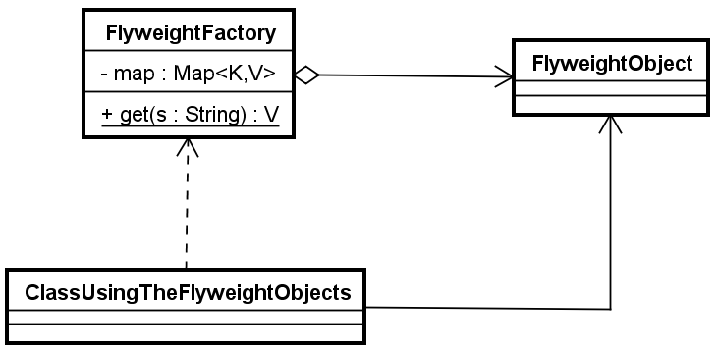
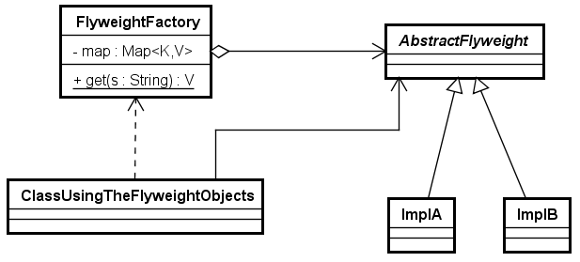
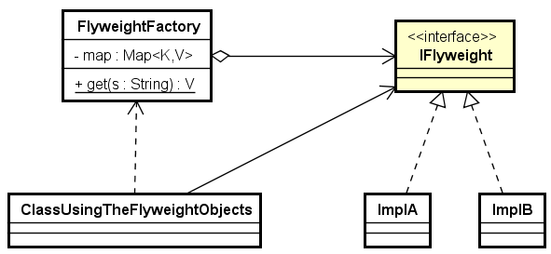
General UML
The get-method of Factory can take any type of arguments.

Slide 32

Agenda
Flyweight, Factory, Map
Map, collection, what is it
Concept, Key-Value
Example
Flyweight
Motivation
Car example
School example
Flyweight definition
String in java
Parts involved
General UML
Code example, students and courses
Code example, MVVM-ViewHandler

Slide 33
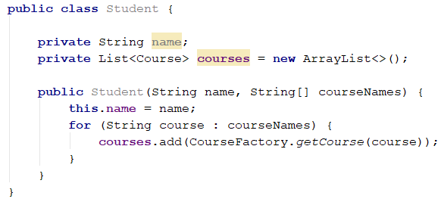
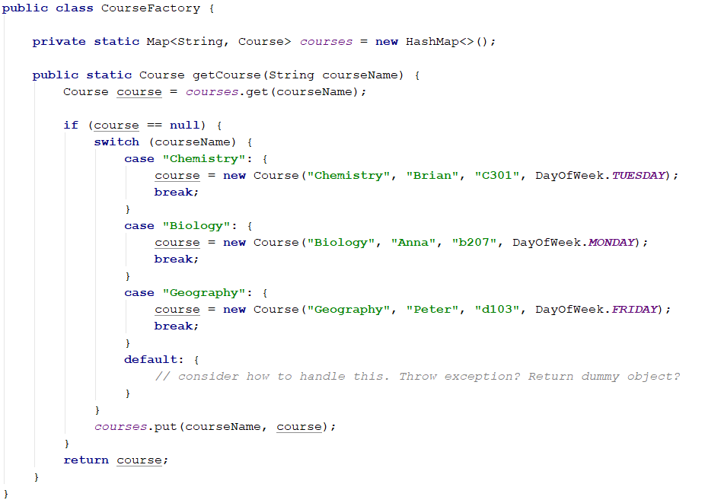
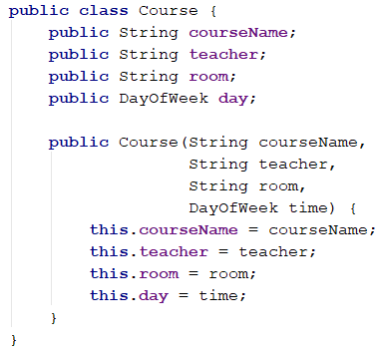
Example, Student and courses

Slide 34

Agenda
Flyweight, Factory, Map
Map, collection, what is it
Concept, Key-Value
Example
Flyweight
Motivation
Car example
School example
Flyweight definition
String in java
Parts involved
General UML
Code example, students and courses
Code example, MVVM-ViewHandler

Slide 35
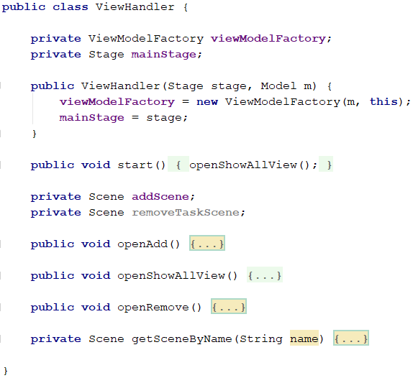
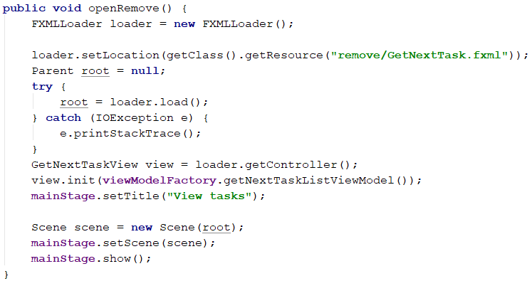
Move construction to a Factory class. Store the resulting Scene object.
The SceneFactory must know about the VMFactory
Move to factory

Slide 36

Agenda
Flyweight, Factory, Map
Map, collection, what is it
Concept, Key-Value
Example
Flyweight
Motivation
Car example
School example
Flyweight definition
String in java
Parts involved
General UML
Code example, students and courses
Code example, MVVM-ViewHandler

Slide 37


